Slide 1
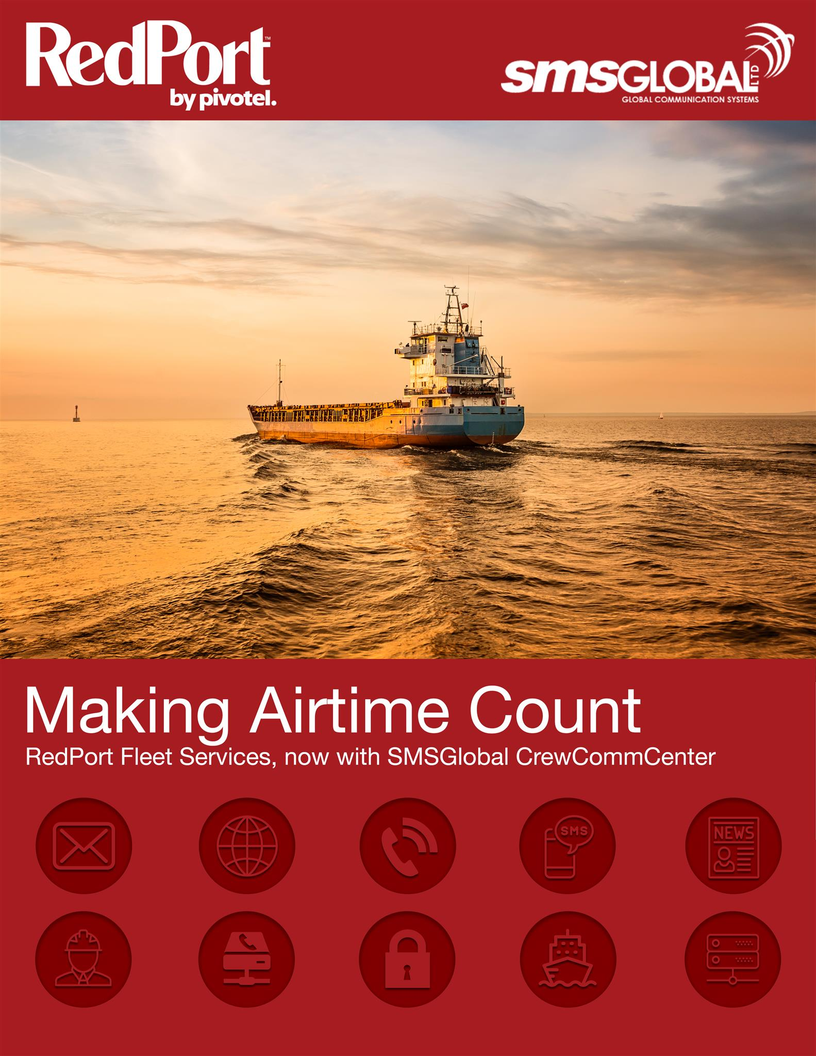



Product presentation

Slide 2
SMSGlobal’s CrewCommWifi available on RedPort’s Optimizer routers
  CrewCommCenter provides full control of the vessel network. All features are remotely managed from an onshore web portal, centralizing the IT management fleet-wide
  The crews can use any smartphone, tablet or laptop that's connected to the Wi-Fi network and access a range of added-value features within limits set by the ship owner
  RedPort Optimizer routers features a range of optional value-added services, vessel E-mail and network administration tools for the vessel operations
  Business applications & vessel mail system can be routed to have direct Satcom Internet connection
  Remote network administration, system configuration & usage statistics from onshore portal
  A cost-effective solution with feature-rich services
  Together: RedPort and SMSGlobal provides a complete solution , Wi-Fi access point, firewall, captive portal and a proxy server, crew and operations – all in one unit

Slide 3


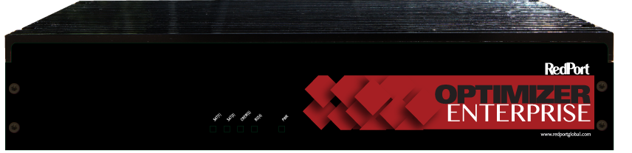
Crew Communications and Business Network Administration
Optimizer
CrewComm
Optimizer
CrewComm
Premier + LTE
Optimizer
CrewComm
Enterprise + NSD
Router, Firewall, Hotspot, PBX Ideal For: Voice and E-mail, Tracking, NMEA+ Manual Switching between Wi-Fi, Crew, Cell and Satellite | Router, Firewall, Hotspot, PBX with Captive Portal, Ideal For: Web, Voice, Email, Tracking, NMEA, Crew + Automatic Switching between Wi-Fi, Cell and Satellite | Router, Firewall, Hotspot, PBX with Captive Portal and Caching Ideal For: 20+ users, Web, Voice, E-mail Tracking, NMEA, Crew + Automatic Switching between Wi-Fi, Cell and satellite

Slide 4
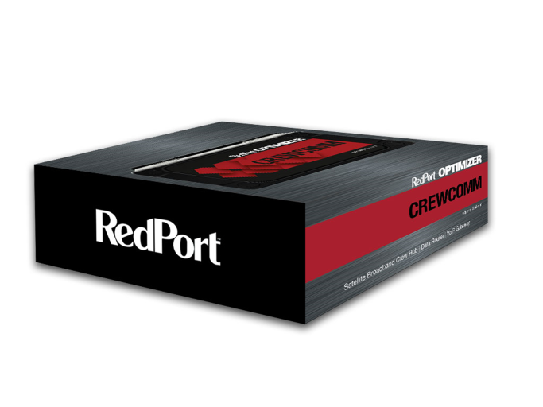

Slide 5


Case Study: Small Commercial
Hardware
Optimizer CrewComm or Premier
$299/$460
Router, Firewall, Wi-Fi
PBX, Email Server, Crew Portal
NMEA, Tracker
Services
XGate
CrewCommCenter
$20-100/month
Prepaid Voice
Vessel E-mail & Photo Sharing
Web Compression
Weather – Predict Wind Lite
Social - FB, Twitter, Sail blogs
Vessel Tracking
Crew SMS, Chat, Crew Email,
News, Announcements

Slide 6

Case Study: Large Commercial
Hardware
Optimizer Enterprise
$1199-2099
Router, Firewall, Wi-Fi
PBX, E-mail Server, Passengers &
Crew Portals
NMEA, Tracker
Services
XGate
CrewCommCenter
$80-100/month
Prepaid Voice
Email & Photo Sharing
Web Compression
Weather – Predict Wind Lite
Social - FB, Twitter, Sail blogs
Vessel Tracking
Crew SMS, Chat, E-mail,
News, Announcements

Slide 7
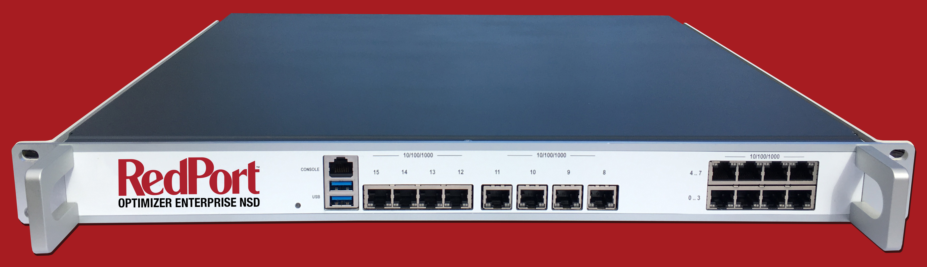
Social Media Posting
RedPort Optimizer Enterprise NSD
- Easy to install
- Easy to Support
- Full Optimizer Enterprise Router
- No External Switch Required
- Half-Depth 1U Rack Supports ALL Vessels
- CrewCommCenter
- Fleet Secure
- Fleet Edge
One of only two future platforms

Slide 8








A stand alone solution
Satellite
Crew Contact
Satcom Terminal
SAS
Trench
Internet
SMSGlobal servers
2
Crew Contact
Crew devices
Business Network
Business Solutions
An End-to-End Satellite Communication Solution
Notes:
Hide

Slide 9
Firewall & Access Control
All routers haves fully configrable firewalls for business and crew network with a simple web based interface
Configurations are done on the shore web support portal and remotely uploaded to the routers
Ship owner can select between pre-sets such as which social instant messaging applications that the crews can use, if video-audio calls can be made, and if web browsing shall be allowed
Complete controll of which ports, domains and ip’s thats allowed or blocked
Direct access to the Satcom Internet connection for specified ports and business application ip’s
Separate crew and business lan networks
Remote access to the routers trough http
Remote settings of WAN / LAN IP’s and mode
Remote settings for incoming port forwarding
Notes:
Hide

Slide 10
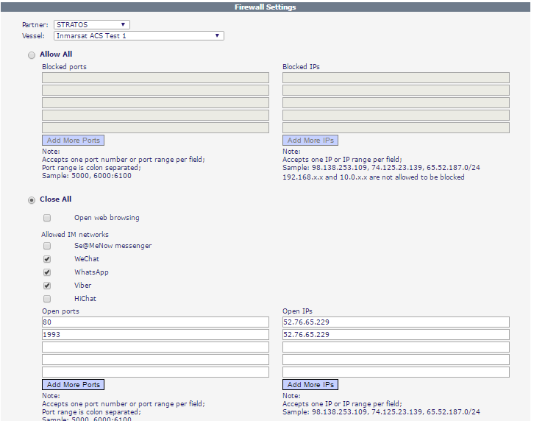
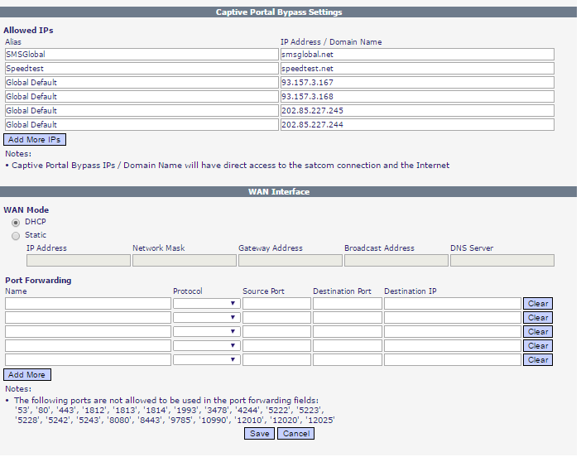
Firewall & Access Control Screenshots
Notes:
Hide

Slide 11
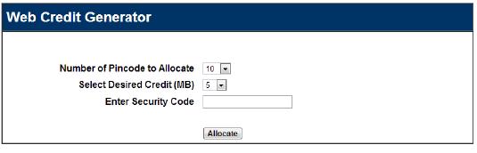
System data usage – Free data & time allowances – Pre-Paid
All system features can be configured to be free for the crew to use within specified data and time limits per day/month, or to be pre-paid trough reload strings
Data credit reload strings are generated by ship owner on a shore web portal:
The data strings size, number and price to crew is decided upon and managed by the ship owner
The crews insert the data strings within the user interface and their data allowance will be topped up
This feature is ideal for customers that like to to charge the crews for the Internet usage
Notes:
Hide

Slide 12
Crew system configurations that suits all needs
Fleet One
Wi-Fi access on smartphones & tablets for online messaging on LINE, WeChat FB Messenger, WhatsApp, & Viber Firewall & access control configurable with data and time limits per vessel per day & month
Fleet Broadband & Fleet Xpress
Wi-Fi access on crew devices with a range of added-value feature options: E-mail, SMS, low-data chat & social networking trough crews own apps Captain & Fleet Announcements World-News Limited crew Internet access Pre-paid & post-paid access control Firewall & apps access control Business & Crew networks control
Fleet Xpress – V-Sat
Wi-Fi access on crew devices with configurable Internet usage control Pre-paid & post-paid billing modules Firewall & apps access control Business & Crew networks control
Notes:
Hide

Slide 13
Benefits & Advantages
A cost-effective solution with feature-rich services Addresses both crew communications and business operation needs An all-in-one vessel network solution Simplified installation, management and support Perfect for low-data or high-data satellite packages Low-cost alternative to more complex network management solutions Lightweight router with powerful hardware Simplified management of essential requirements for crew and business communication Perfectly fitted for Internet entry vessels with limited data allowances
Usage scenarios
Fishing vessels with limited bandwidth and data allowances Merchant vessels with restricted crew Internet allowances and separate business network requirements Replacement of current vessel firewall whereas existing rules can be maintained, and all the added-value CrewCommCenter communication features are included A complete solution working with Fleet One, Fleet Broadband and Fleet Xpress
Notes:
Hide

Slide 14
For the Crews
Internet access on the crew's own devices Use of social networking apps installed on crews devices within the allowances set by the ship owner Low-data text chat with interface to FB Messenger Announcement board for Captain and Fleet Management Personal E-mail accounts following the crew from vessel to vessel and web access while on shore Send & receive SMS messages world-wide with local reply numbers in Philippines World-News delivered daily in 16 multilingual editions Se@MeNow maritime social networking, with messenger app for video & voice calls optimized for high latency networks Compatible with AmosConnect Crew accounts
For the Ship Manager
Plug & Play Wi-Fi router with no additional software installation. Interface with additional Wi-Fi modems infrastructures Full control of business and crew networks Announcement board for Captain and Fleet Management On-shore administration portal with multiple options for Internet access cost & usage control, data, time allowances Free allowances for crew to access the Internet within configurable data & time limits, or pre-paid data strings Online pre-paid data string generator Online usage statistics with Fleet, vessel and crew usage One contact point to the crew, independent of which vessel they are located and while they are on shore
Notes:
Hide

Slide 15
User Interface
Notes:
Hide

Slide 16
User Interface
Notes:
Hide

Slide 17
User Interface
Notes:
Hide

Slide 18
User Interface
Notes:
Hide

Slide 19
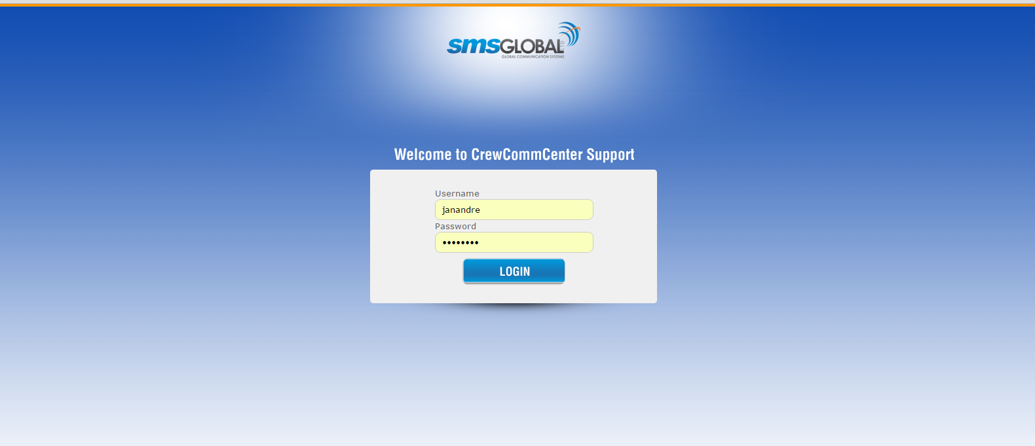
Web Support Portal
Online platform for the configuration & support of CrewCommCenter

Slide 20
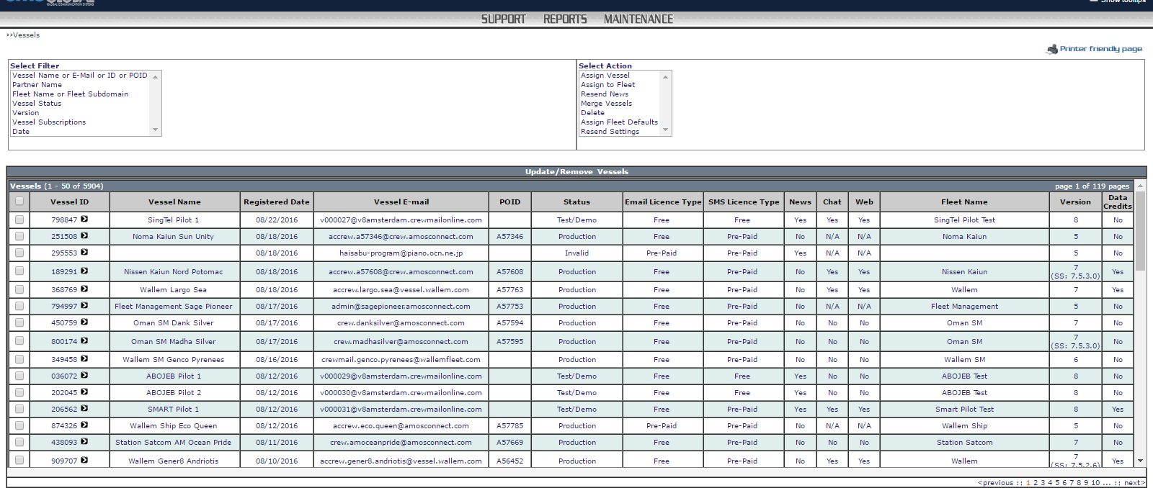
Management Portal
Online platform to register & edit license details
Remote configuration with upload to vessel routers
Configure fleet & vessel settings
Set firewall & access control rules
View usage statistics
Access support knowledgebase

Slide 21


